Slide 1
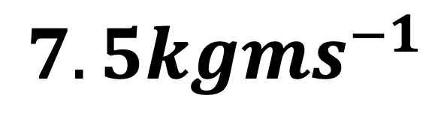
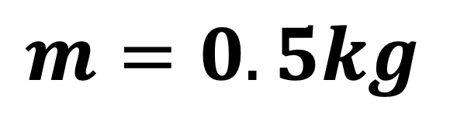
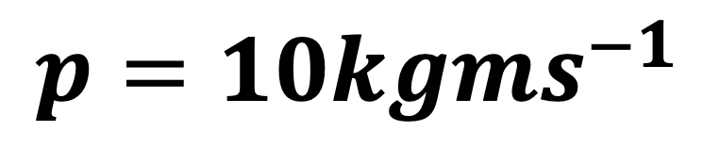
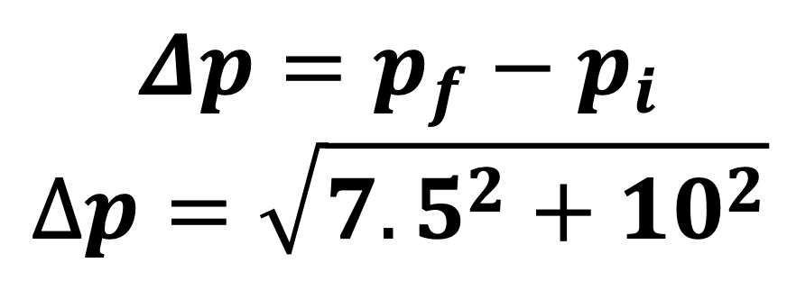
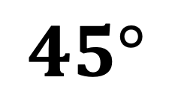
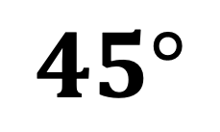
$$m=0.5kg$$
$${7.5kgms}^{−1}$$
$$45°$$
θ
$$Δp=p_{f}−p_{i}$$
$$∆p=\sqrt{{7.5}^{2}+{10}^{2}}$$
$$45°$$
$$p={10kgms}^{−1}$$

Slide 2



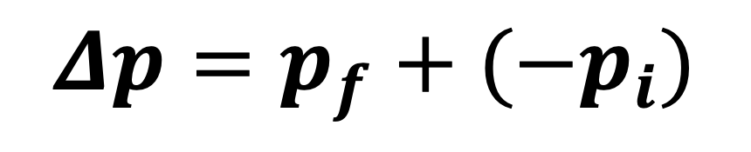
$$Δp=p_{f}+(−p_{i})$$
$$p_{f}=?$$
$$θ$$
$$p_{i}=?$$

